Slide 1
REAL-TIME SURVEY INSTRUCTION MANUAL [Version: 3.0.139]
REAL-TIME ANALYTICS COMPANY
Gambia
2018- April

Slide 2
Table of contents
5. Utilities
1. Introduction of rtSurvey
3. How to use rtSurvey
2. Installation of rtSurvey
Login
Deactivate Registration
Registration
4. Some techniques when filling out the form in the e-form

Slide 3
CHAPTER 1
INTRODUCTION OF rtSURVEY

Slide 4
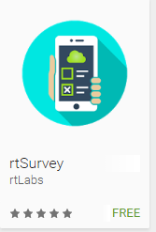
1. Introduction of rtSurvey
Real-time Survey (rtSurvey) is a comprehensive and flexible solution to bridge the gap of information collected in surveys regardless of scale.
The platform consists of two main components: mobile application and Cloud server, which captures and turns raw data into valuable insights on real-time basis.

Slide 5
CHAPTER 2
INSTALLATION OF rtSURVEY

Slide 6
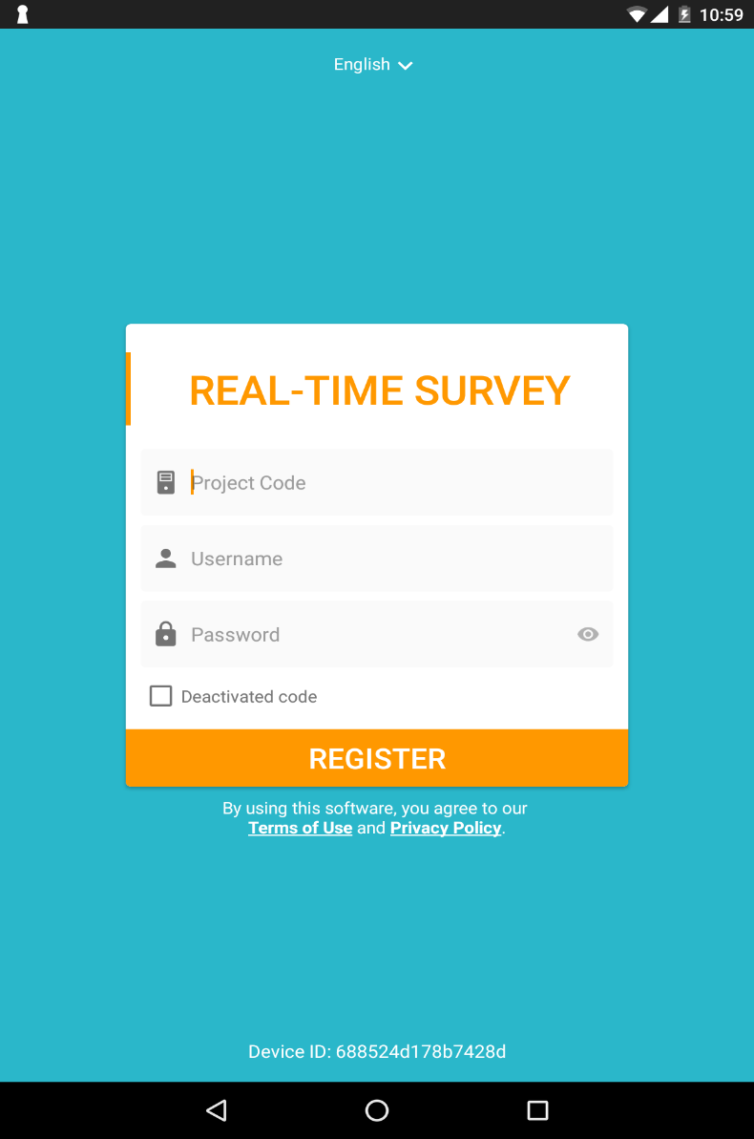
2.1. Registration
Registration rtSurvey to server:
Enter default Project Code as S140
Enter Username and Password as given
Click “Register” after completing
Note: Deactivated code is only used to switch usage of the same account to another device.

Slide 7
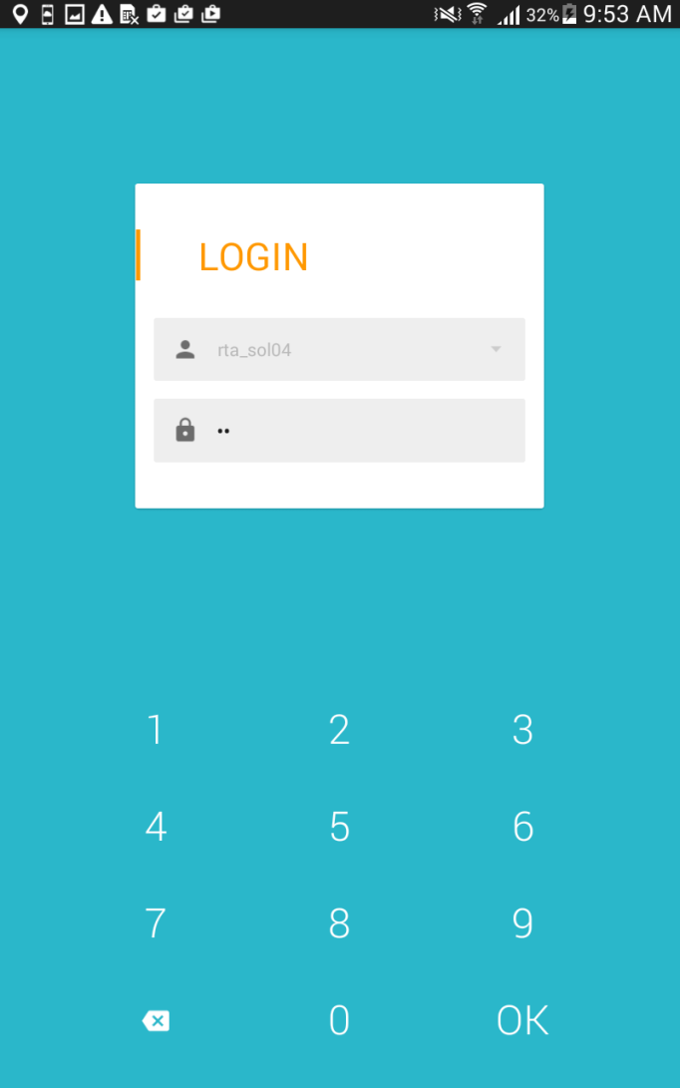
2.2. Login
Following the registered verification process is the logging one.
Enter default password as 1234
Note: This password can be changed in the Home screen (after successfully logging into rtSurvey)
Note: The app version used for rtSurvey is 3.0.139

Slide 8
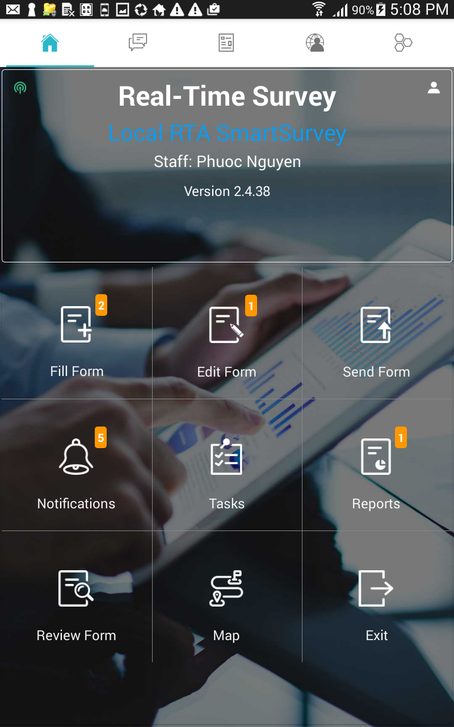
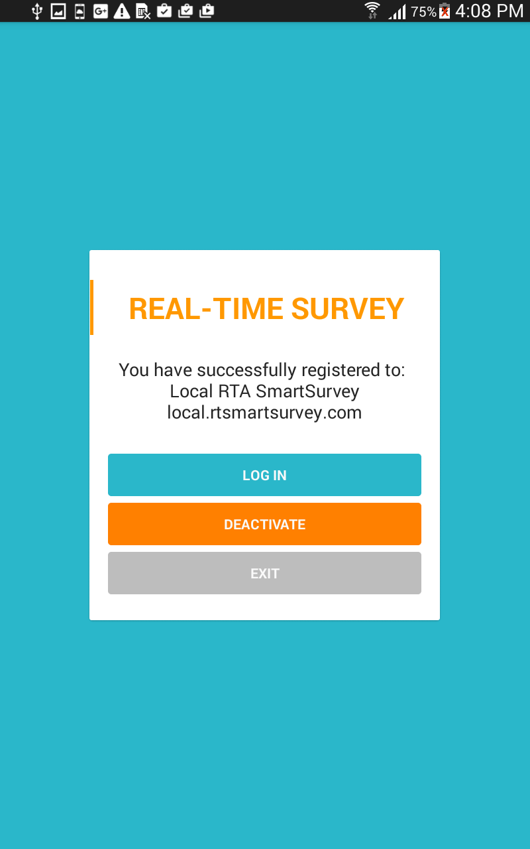

2.3. Deactivate Registration
Tap 5 times continuously on the name of agent
When the next screen appear, click “DEACTIVATE”

Slide 9
CHAPTER 3
HOW TO USE rtSURVEY

Slide 10
3.1. Home screen (1)
Real-time Survey interface is user-friendly with main items:
Enumerators check Username and the version of rtSurvey on the Home screen.
Fill form
Edit form
Send form
Notifications
Tasks
Reports
Review form
Map
Exit

Slide 11
3.1. Home screen (2)
Fill form: Input data collected into the data base.
Edit form: To edit the unfinished instances from enumerator’s device, from server’s returning or from another device forwarded by server
Send form: To submit the 100% completed forms
Notifications: Inform the notice from server
Tasks: Received tasks from server
Reports: Permit user view all the reports which server send to tablet
Review form: To review the finalized forms whether they are sent or not
Map: GPS settle your address of executing the interview
Exit: log out of rtSurvey

Slide 12
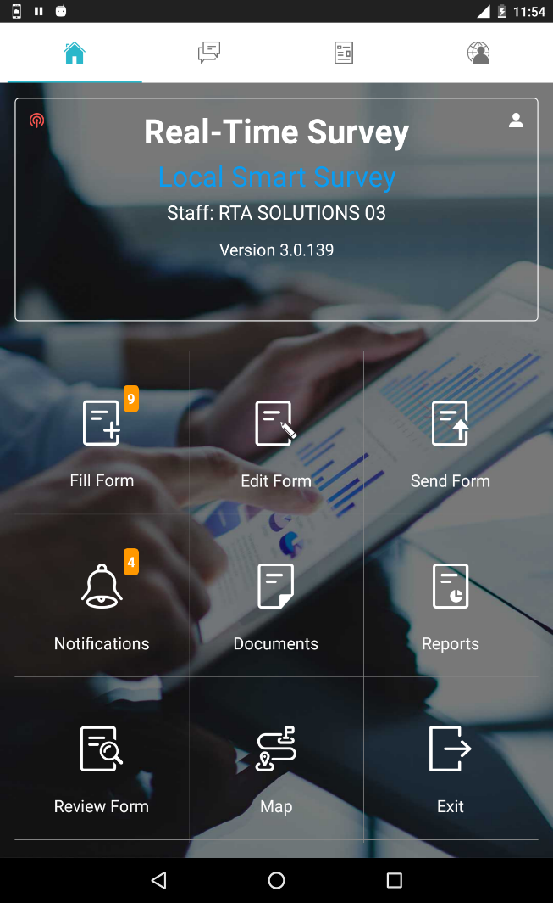
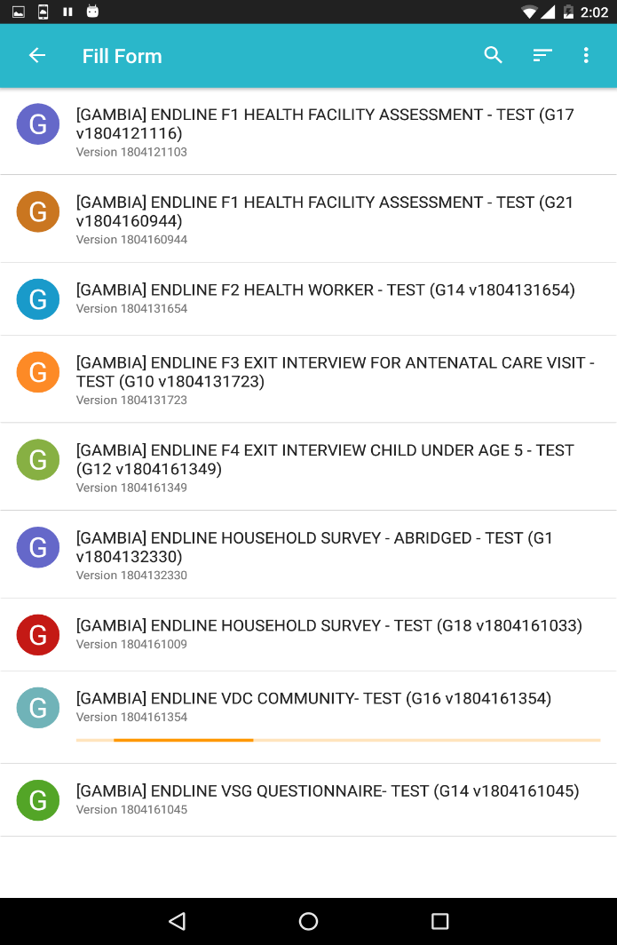
3.2. How to fill out the form?
To start filling form, click “Fill form” on the Home screen
A list of forms will display.

Slide 13
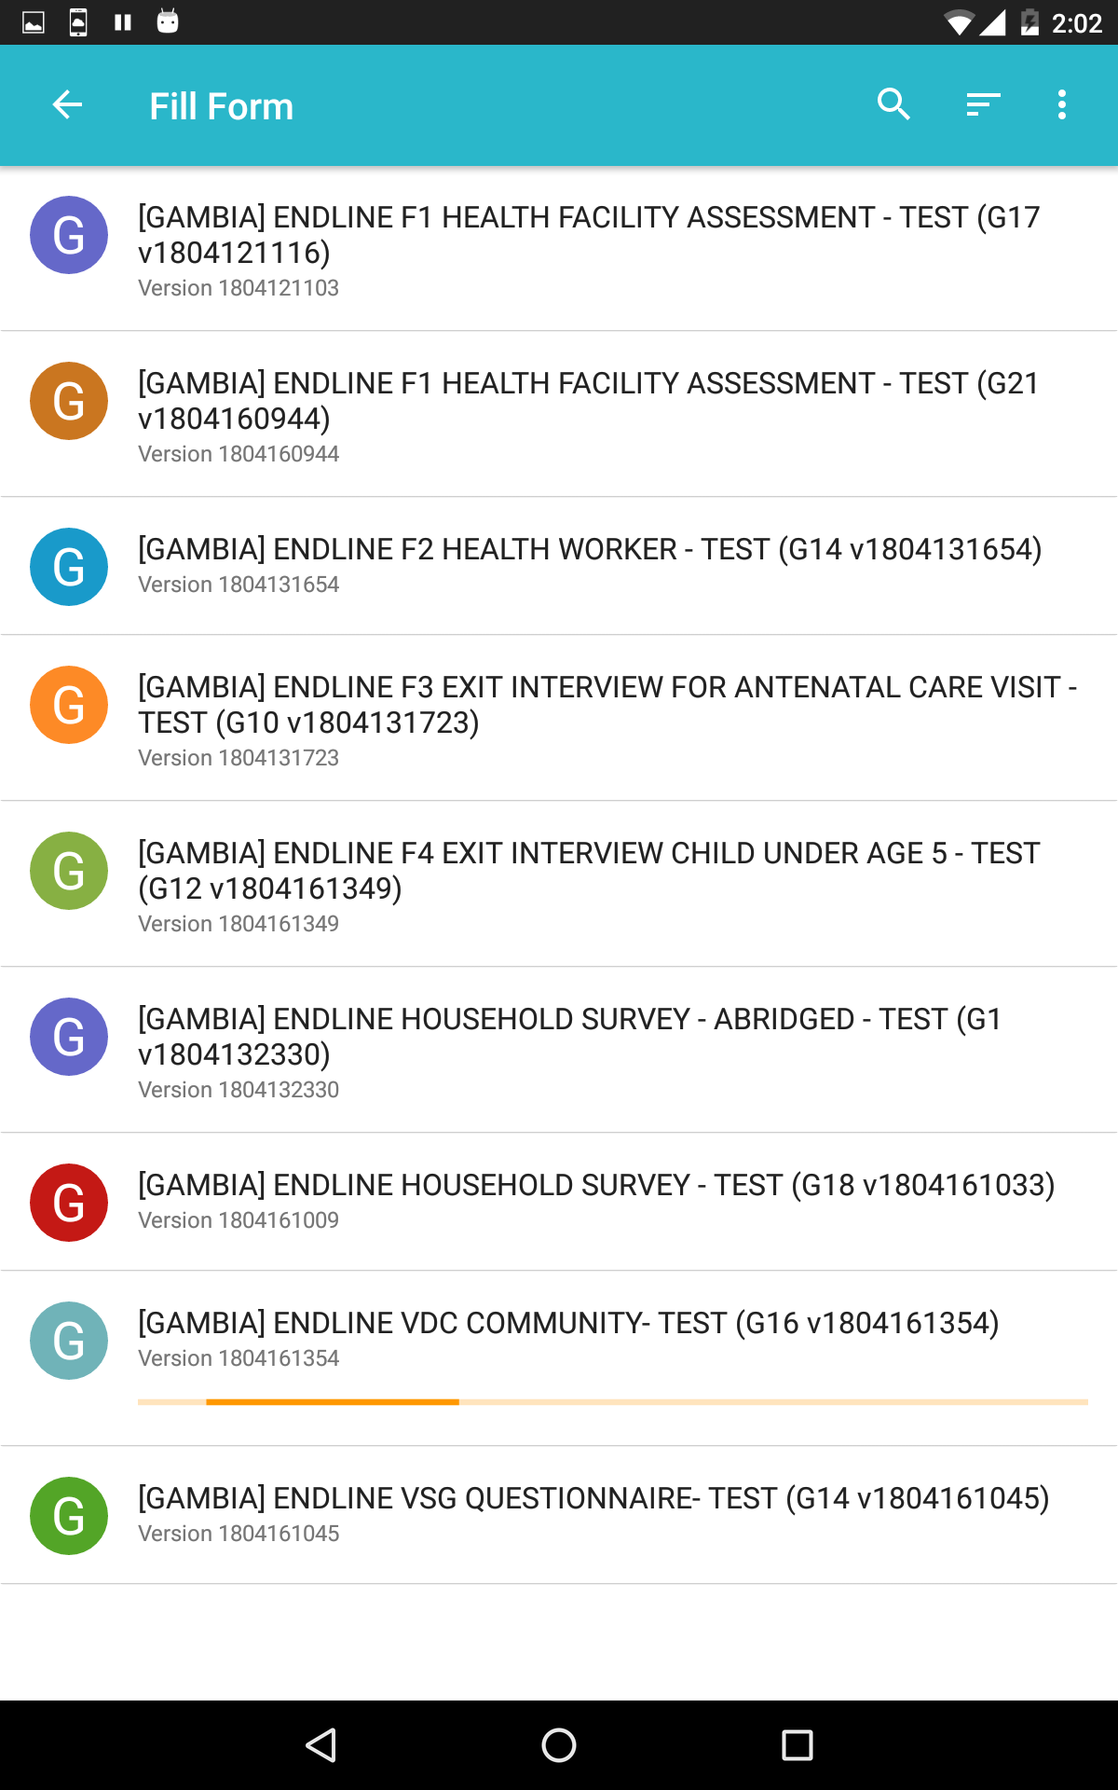
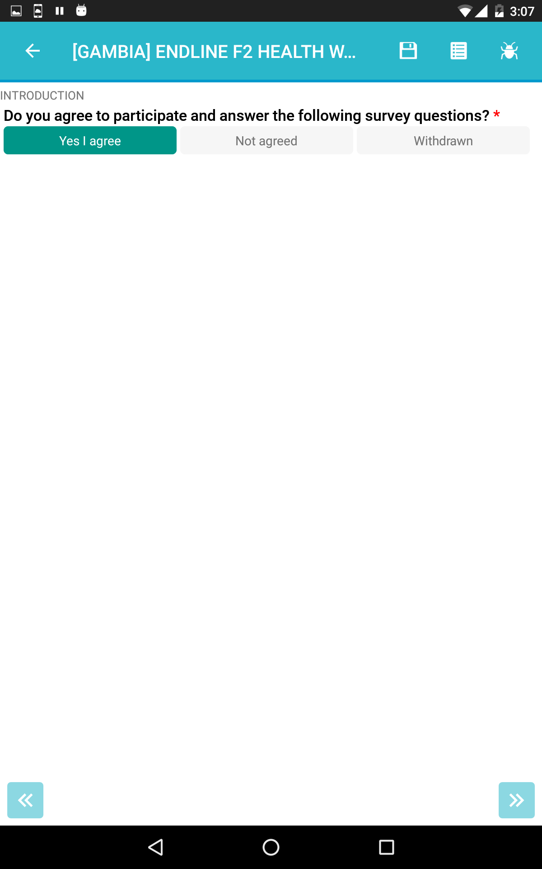



3.2. How to fill out the form? Functions of the icons on the toolbar
Choose the form to fill
Get ready for the form to be opened
4
1 2 3
Utilities:
Save form (without leaving the form filling screen)
Go to table of contents
Notify the error to server
Exit the form
Search form by name
Sort by name
Show unavailable forms
Pin to home screen

Slide 14
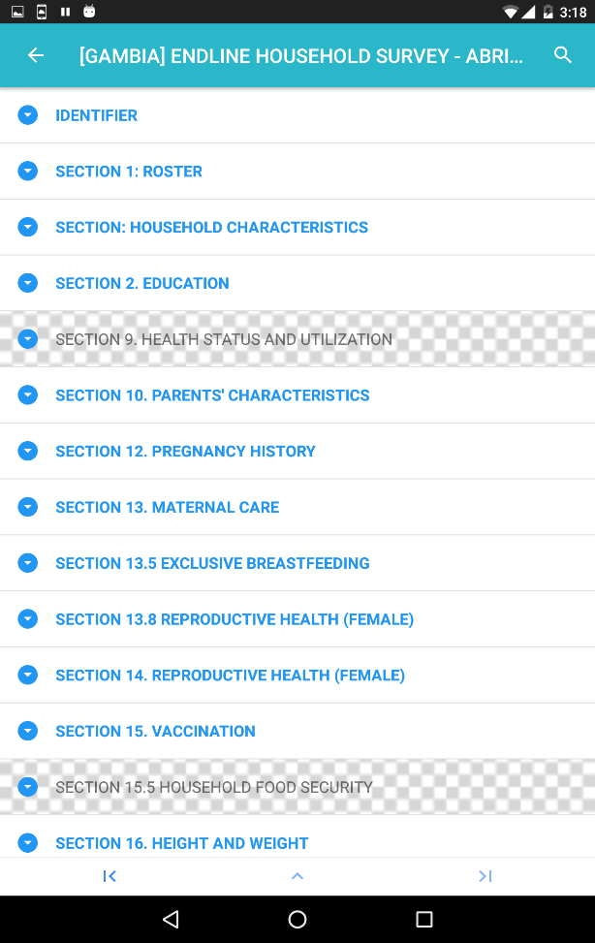
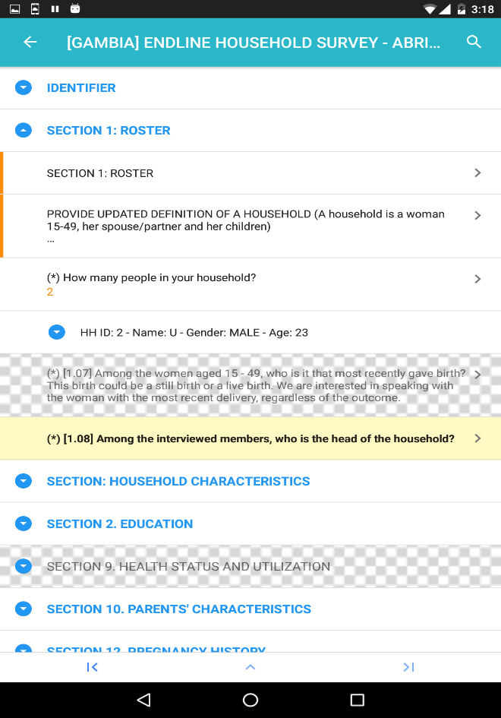
3.2. How to fill out the form? Table of contents
Table of contents: Enumerators can always take an overview of the form by clicking
The content table will then appear in section-order.
Select a specific section to view its entire content.
Tab the section which you want to view more detail or to edit form

Slide 15
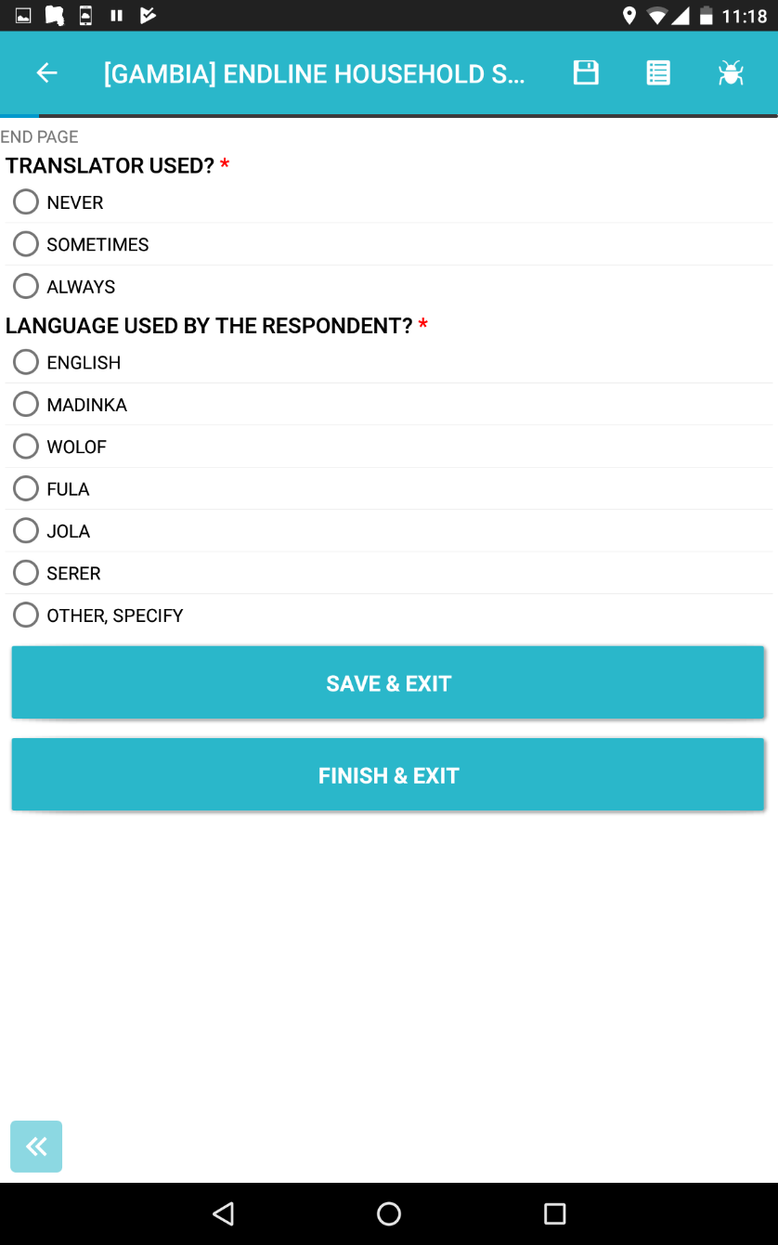
3.3.How to submit form into the server?
In the last screen will have two buttons to choose
SAVE & EXIT: Exit and form are performed is saved in the home page EDIT FORM section
FINISH & EXIT: Completed interview and sent to the Server

Slide 16
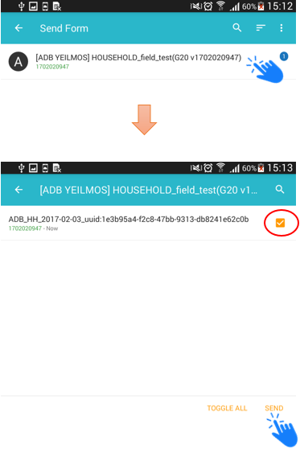
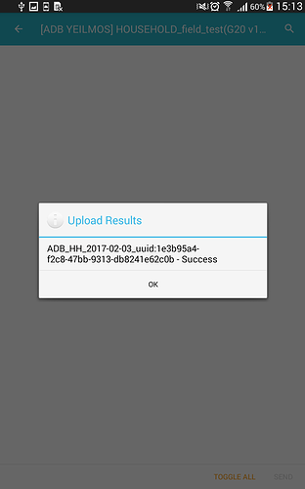
3.3 How to submit form into the server?
Step 1: Select SEND FORM on the main screen | Step 2: Choose form and send | The screen will display a status message
To submit the form into the system successfully, your device (smartphones, tablets..…) should have a stable internet connection.

Slide 17
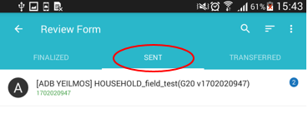
3.3 How to submit form into the server?
Step 3: Examining form successfully sent to the system
Select REVIEW FORM on the main screen and the form located in tab SENT is sent successfully.

Slide 18
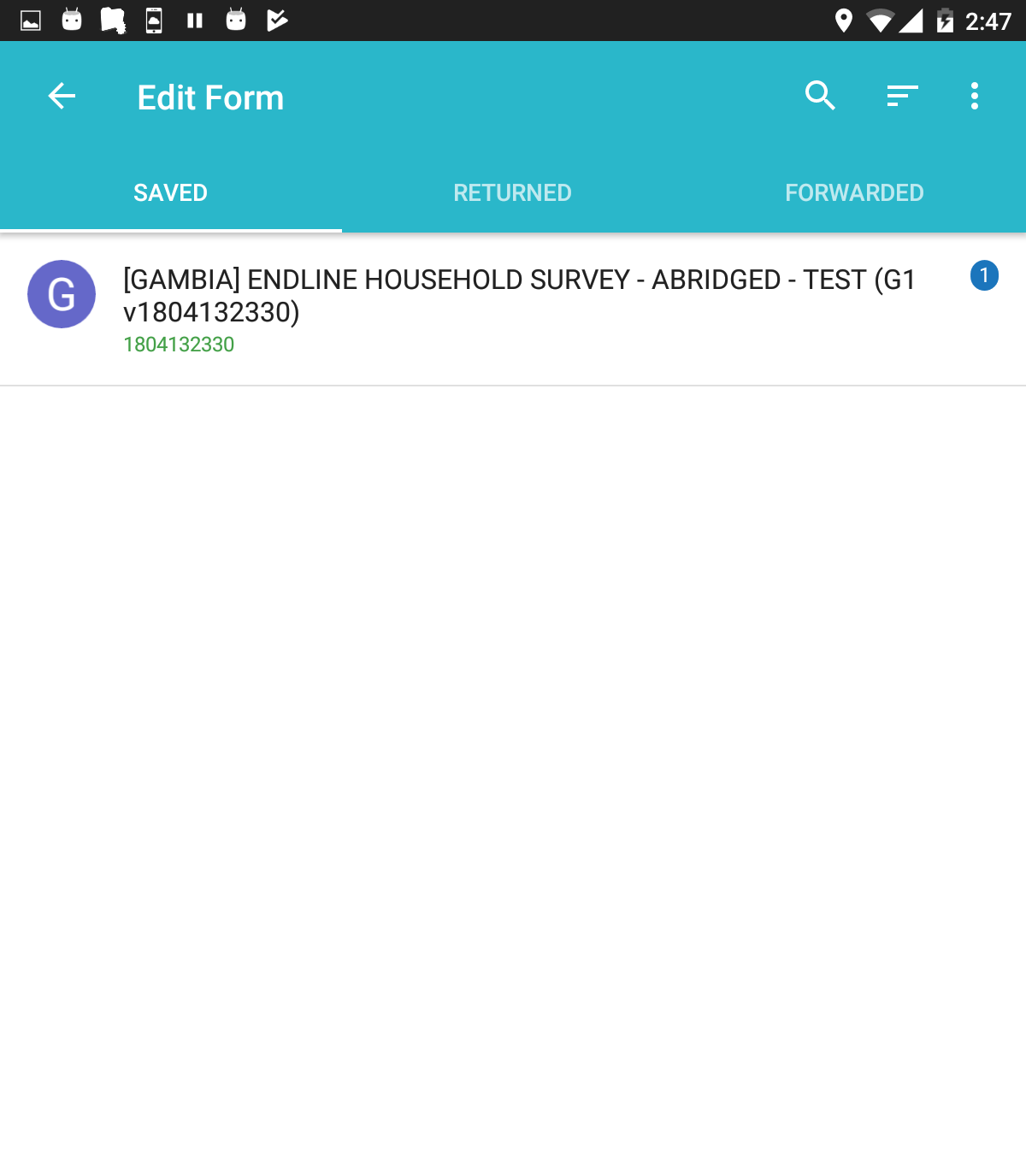
3.4 How to edit the forms?
Select the form to edit in correct category (Saved, Returned or Forwarded)
Edit in the instance.
Then save or finish.
Saved: unfinished forms
Returned: forms that server sent back to the device
Forwarded: forms of other deactivated devices that server sent to the device

Slide 19
CHAPTER 4
Some techniques when filling out the form in the e-form

Slide 20
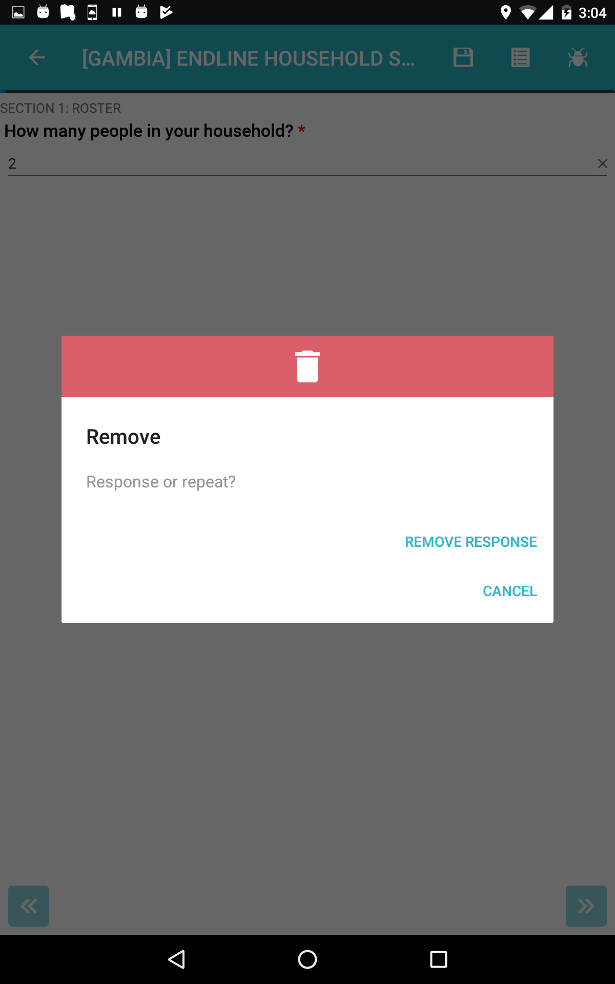
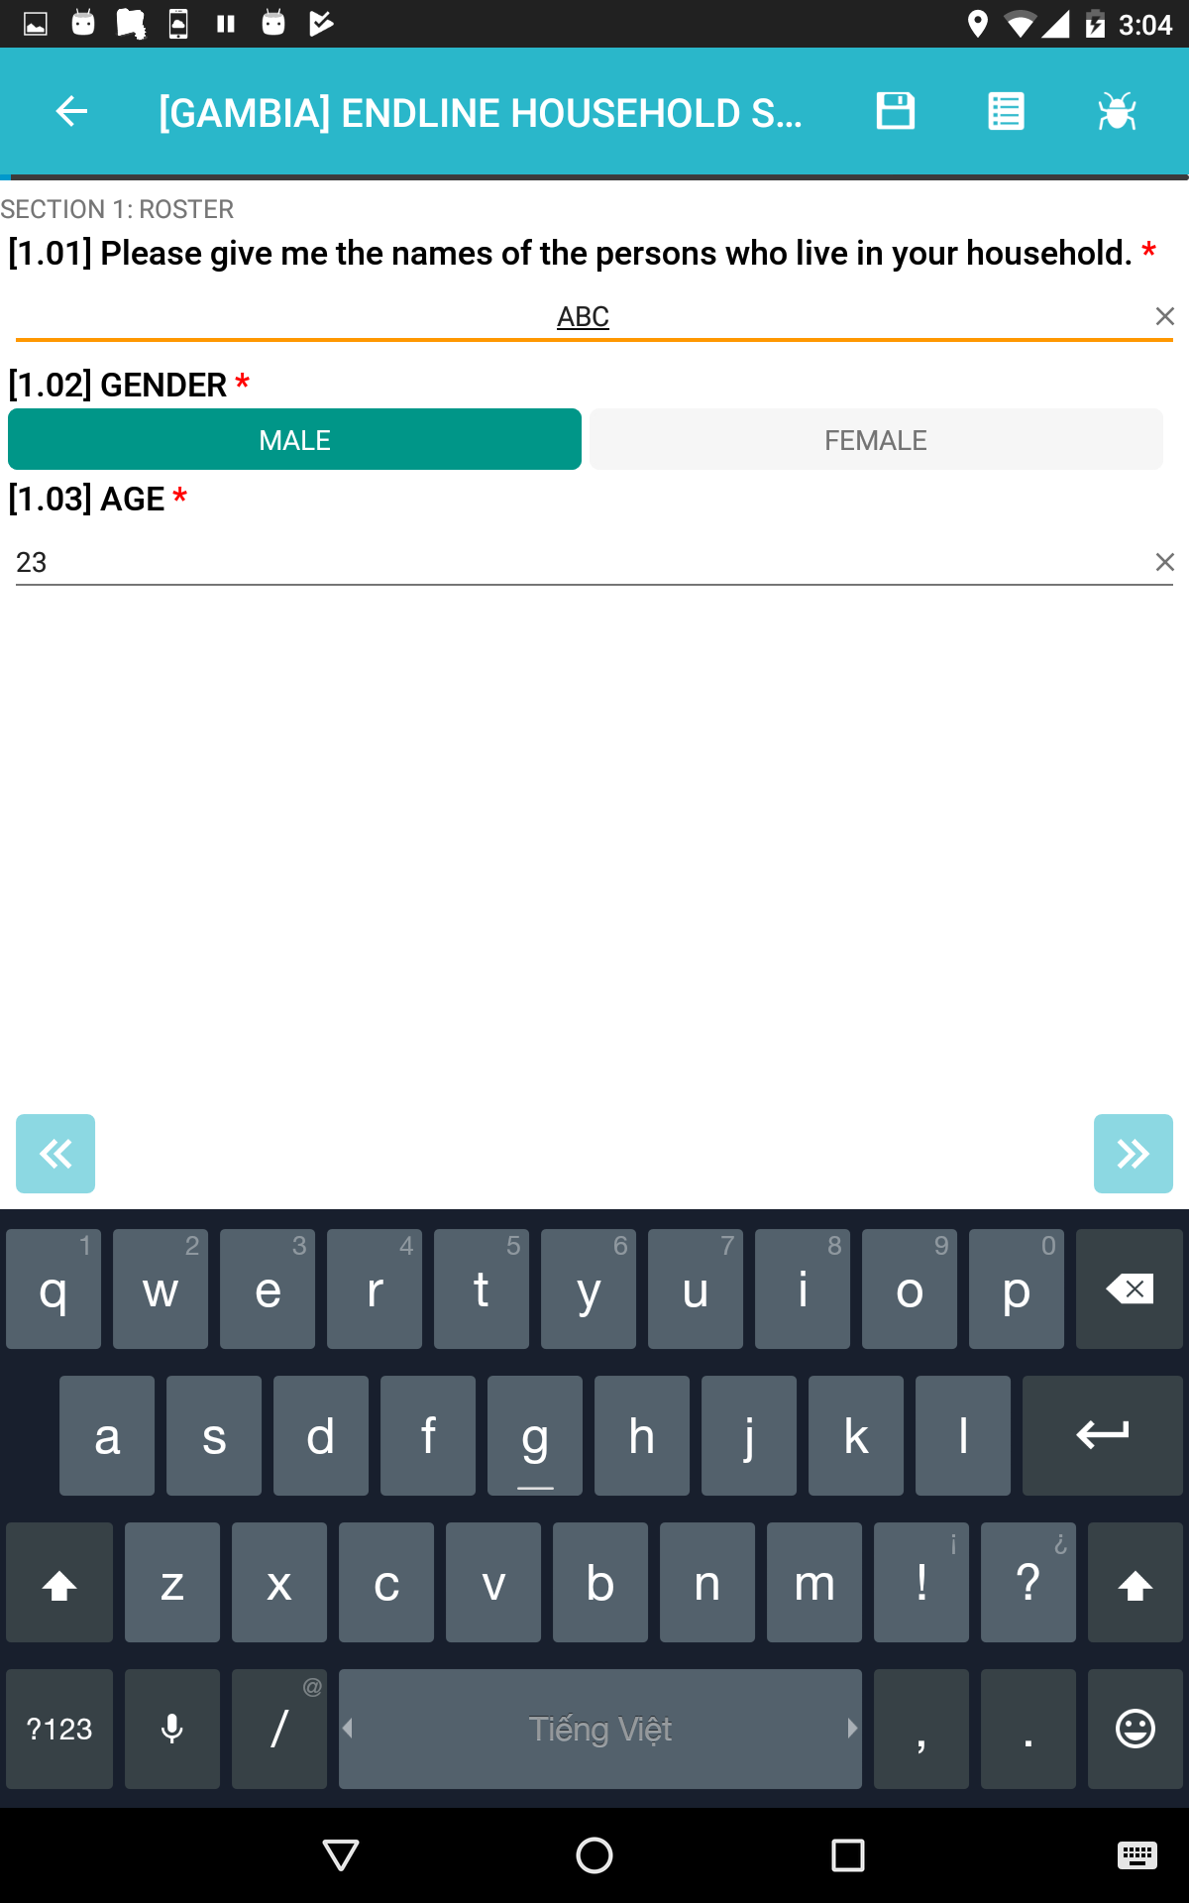
4.1 How to delete answers?
In general, if there is icon “x” in the answer blank, click it to delete. | Besides, if there’s no sign “x”, hold the answers until the remove notification board appear (for about 3 seconds). Some special notes will be specified in each question.

Slide 21
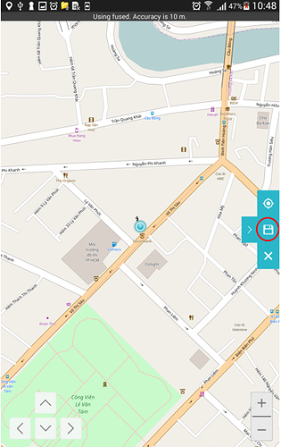
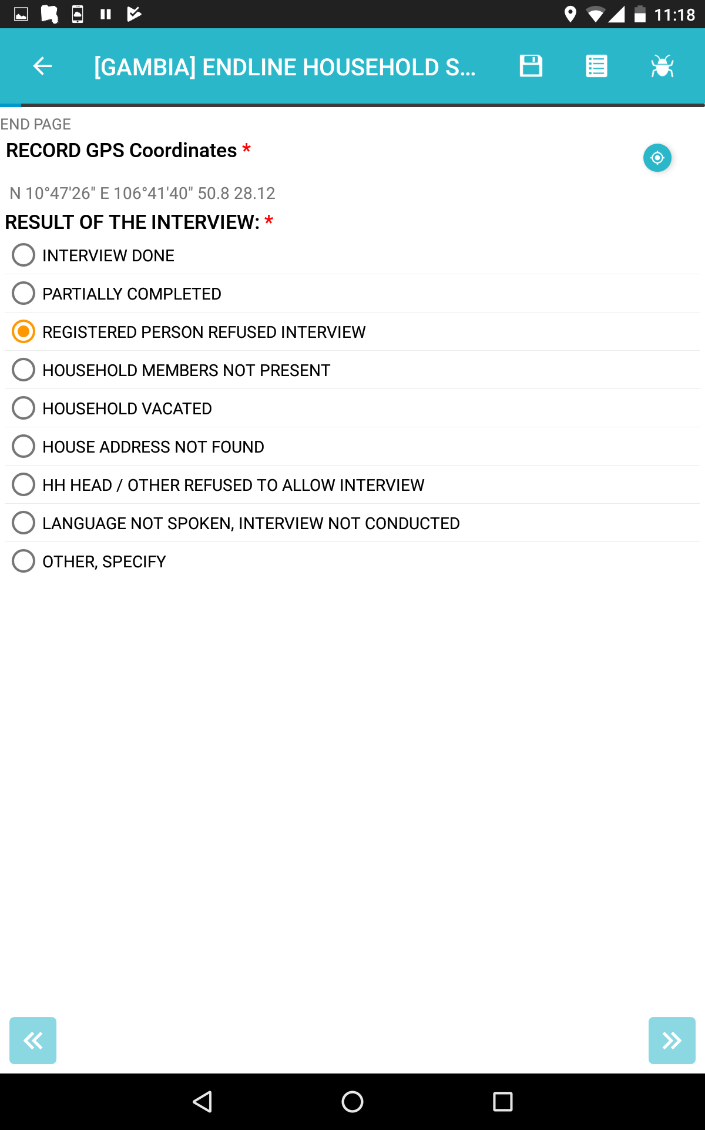
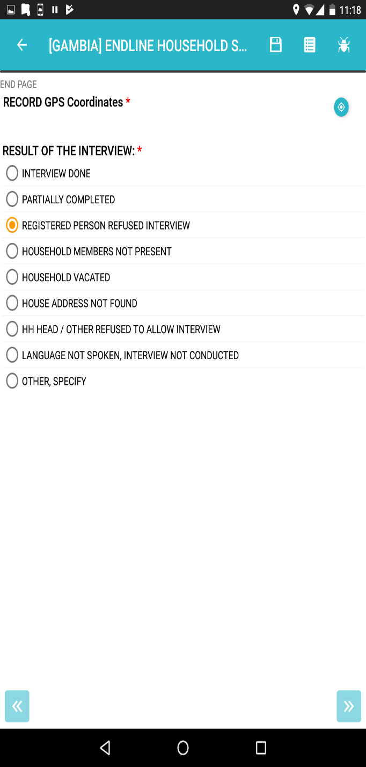
4.2 Get GPS
For questions to get GPS, enumerators click the icon then the map will show the location, click Save to save the position.

Slide 22
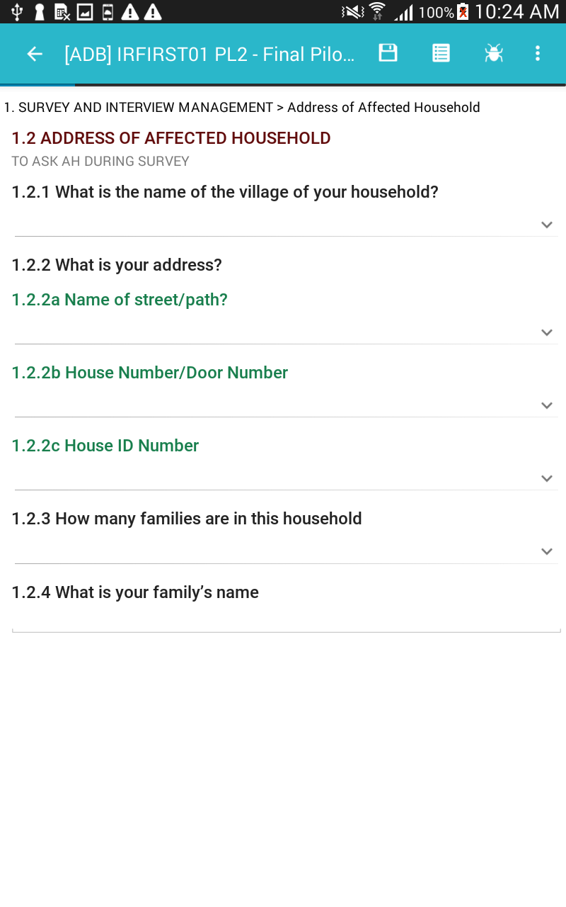
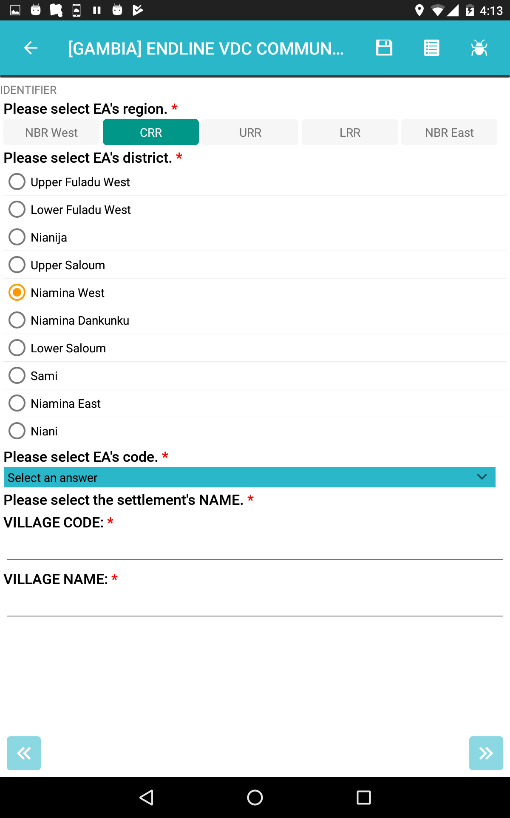
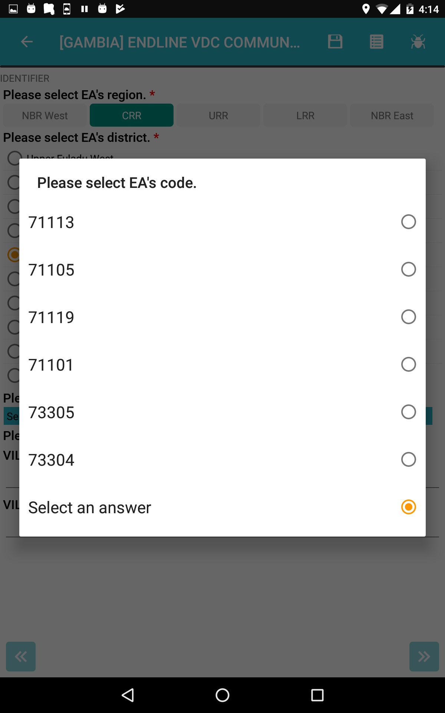
4.3 Dropdown list of answers
At some specific fields, enumerator can enter information by
2. Selecting an option from a dropdown list of answer
1. Clicking on the icon , then either

Slide 23

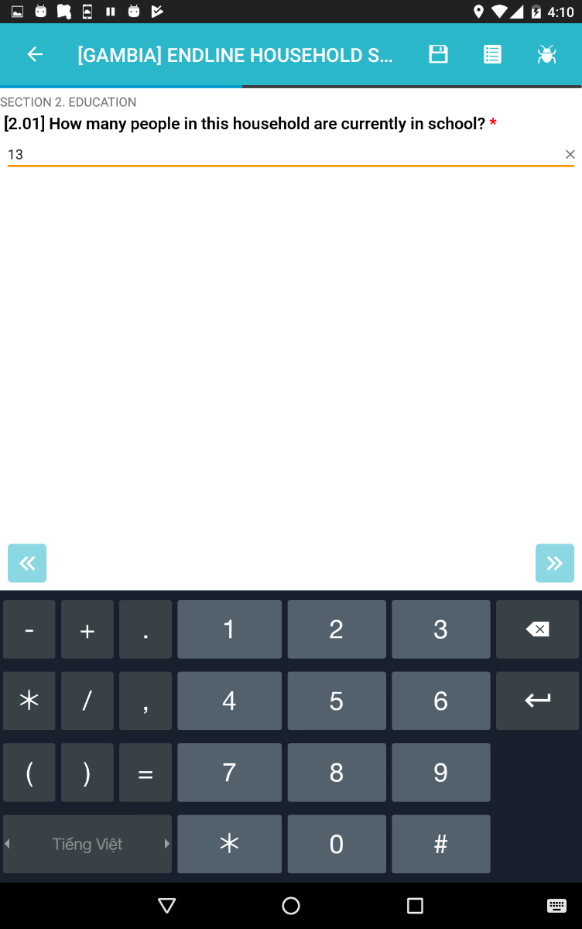
4.4 Enter Text/number
For some specific question, enumerators can enter information by clicking on the blank space and then Input free-text/numbers on the virtual keyboard
Note: The layout of the keyboard will automatically adapt to the type of the needed data type.

Slide 24
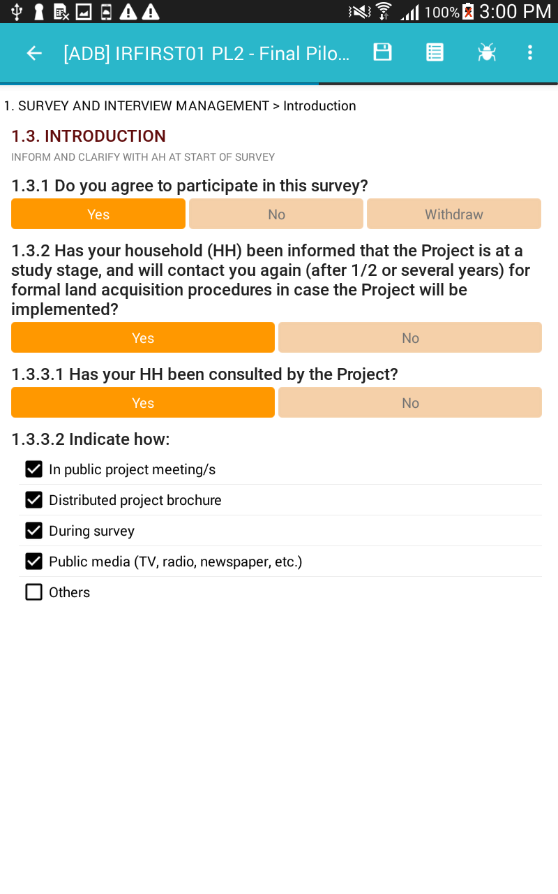
4.5 Multiple-choice questions
MULTIPLE selection answer
These questions which might appear with the checkboxes beside the answers (as the picture on the left) allow respondents to select multiple options from the list.

Slide 25
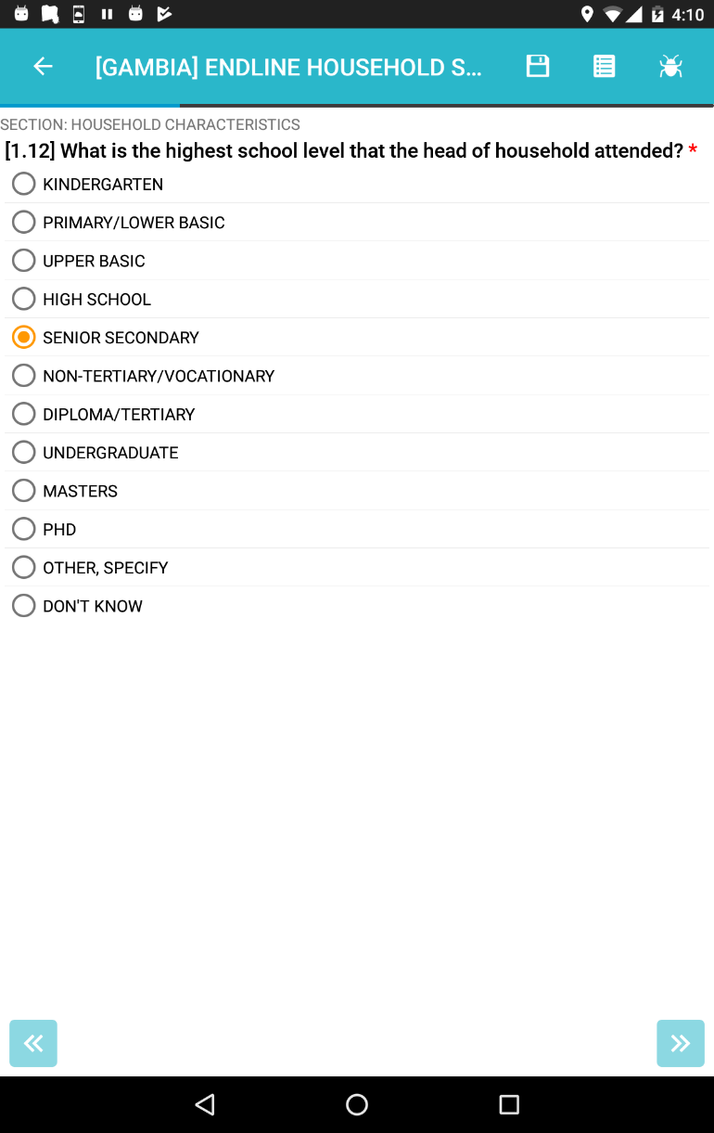
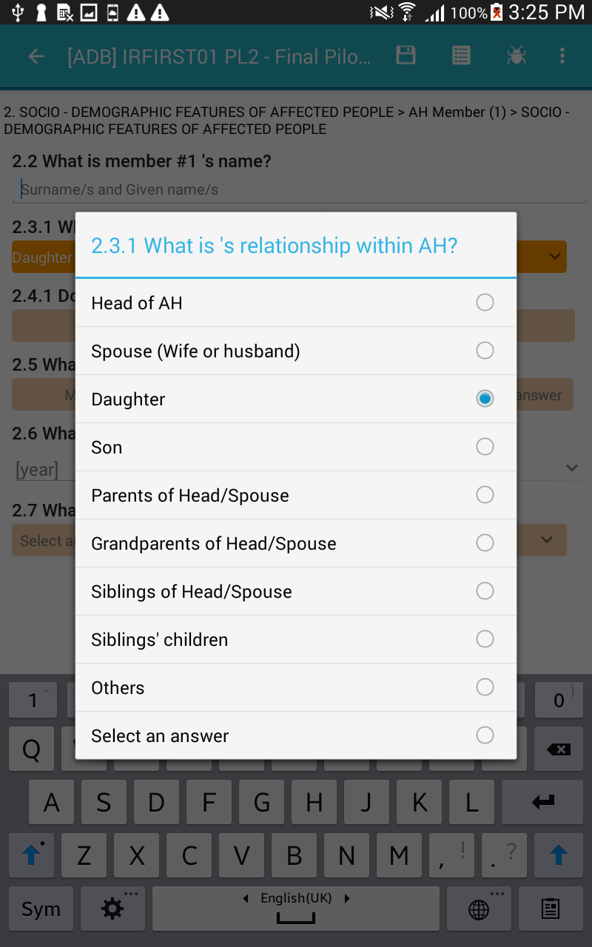
4.6 Single-choice questions
SINGLE selection answer (1)
These questions which might appear with the circles beside the answers (as the picture on the left) mean only one of the options can be selected at any time

Slide 26
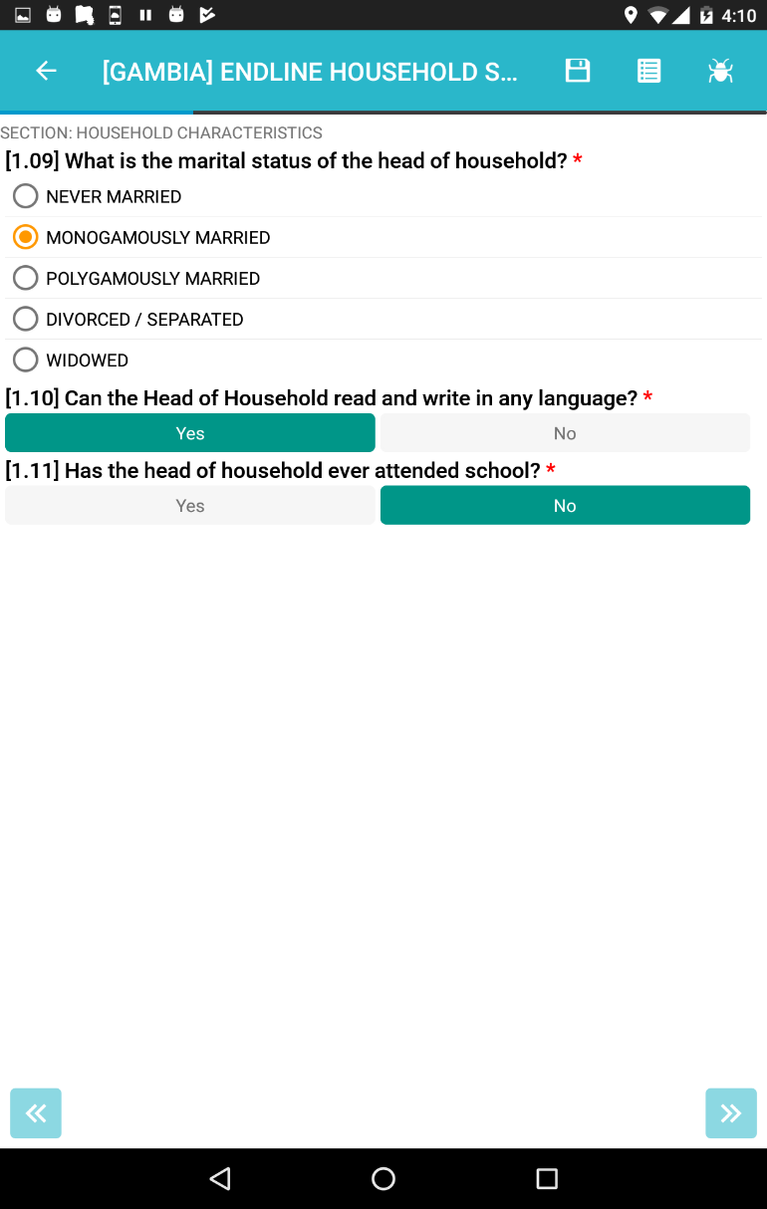
4.6 Single-choice questions
SINGLE selection answer (2)
These questions which might appear with rectangles with answers (as the picture on the left) allow enumerators can select only one of the options at any time.

Slide 27
CHAPTER 5
UTILITIES

Slide 28
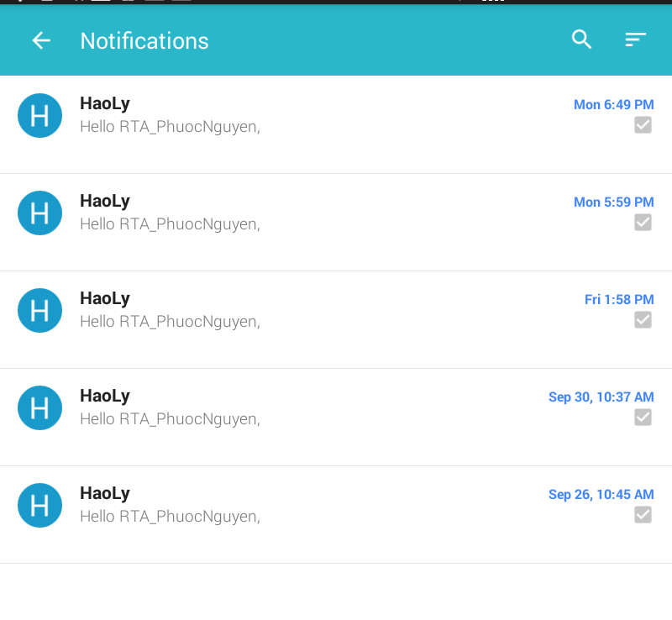
5.1. Notifications
Notifications:
Show the notifications from the server

Slide 29
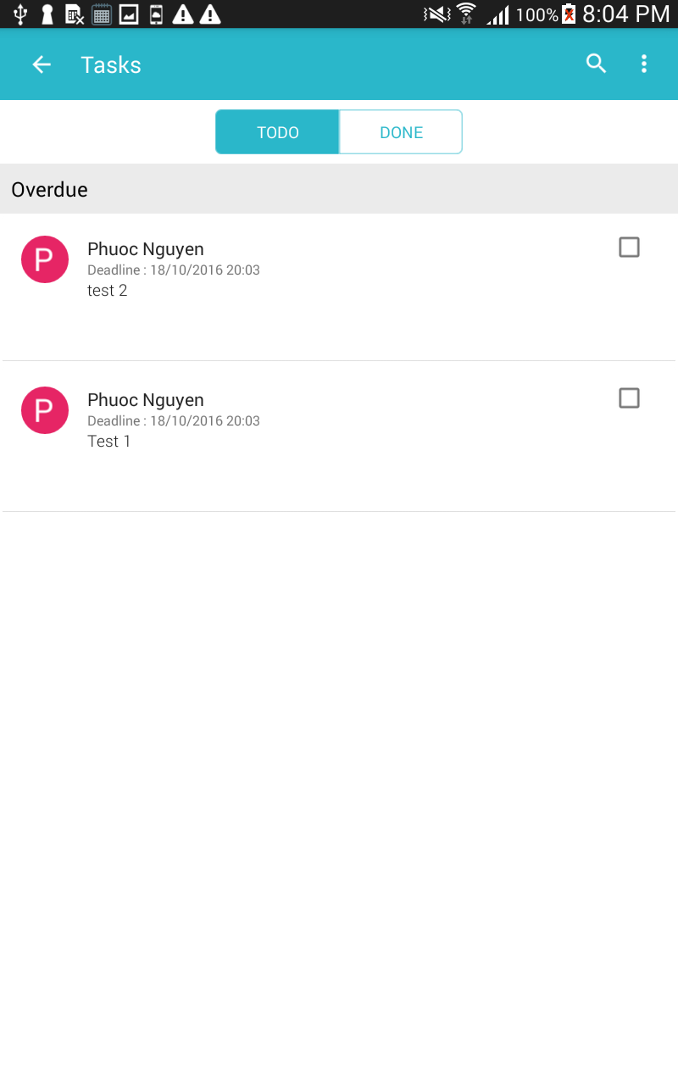
5.2. Tasks (1)
Tasks: tasks sent by supervisors via server

Slide 30
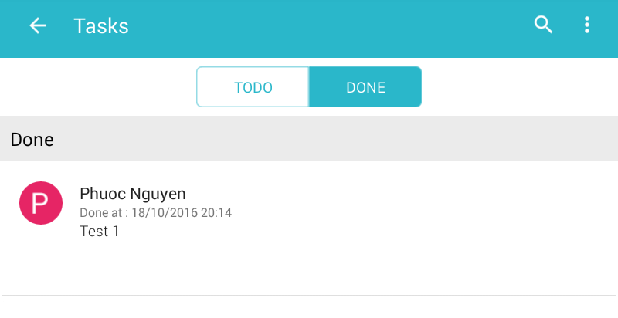
5.2. Tasks (2)
“TODO” tab shows the list of tasks assigned to users
When a task is completed, users click on the check box to move the task to “DONE” tab

Slide 31
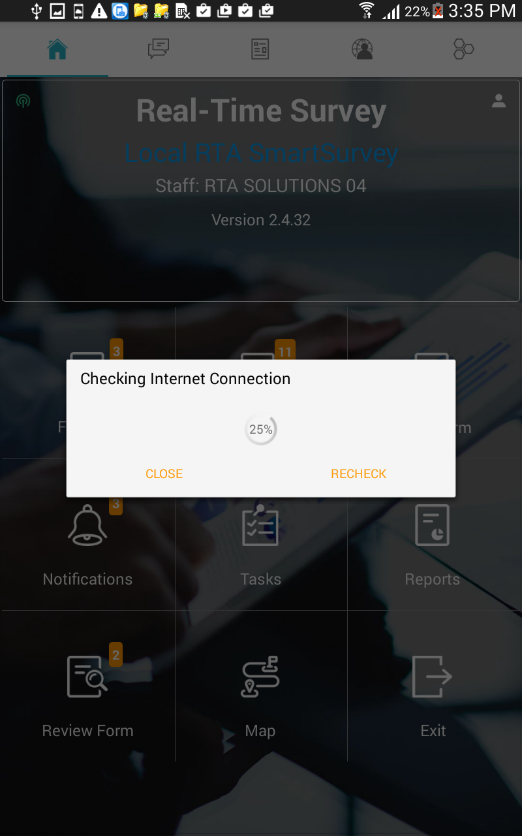
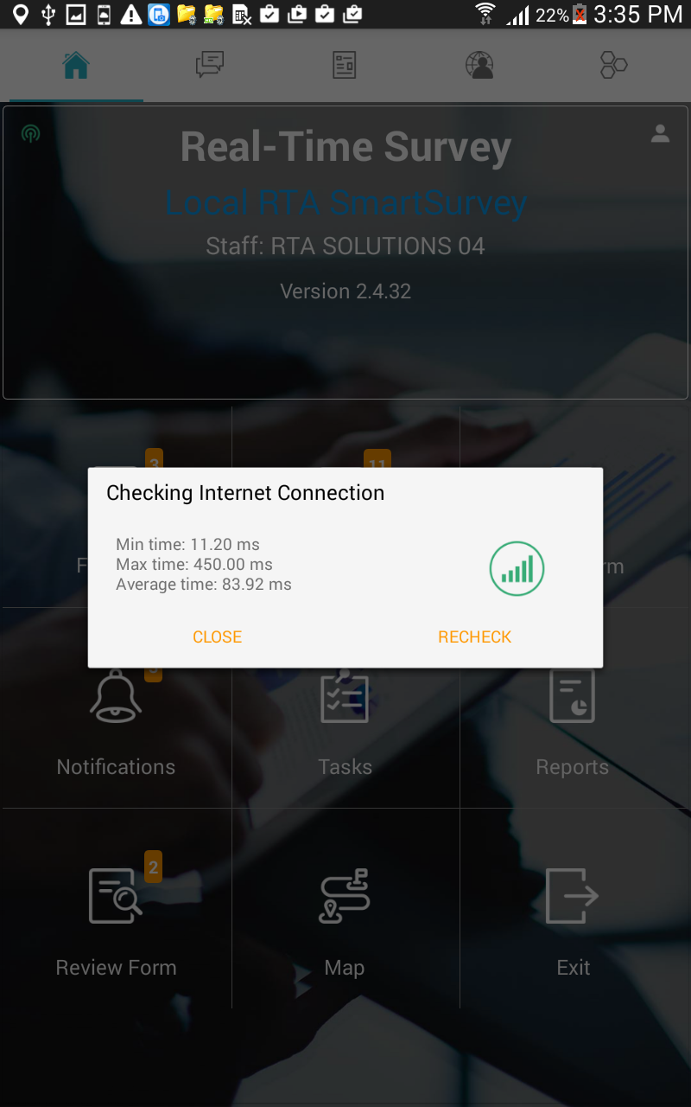
5.3. Check Internet Connection

Slide 32
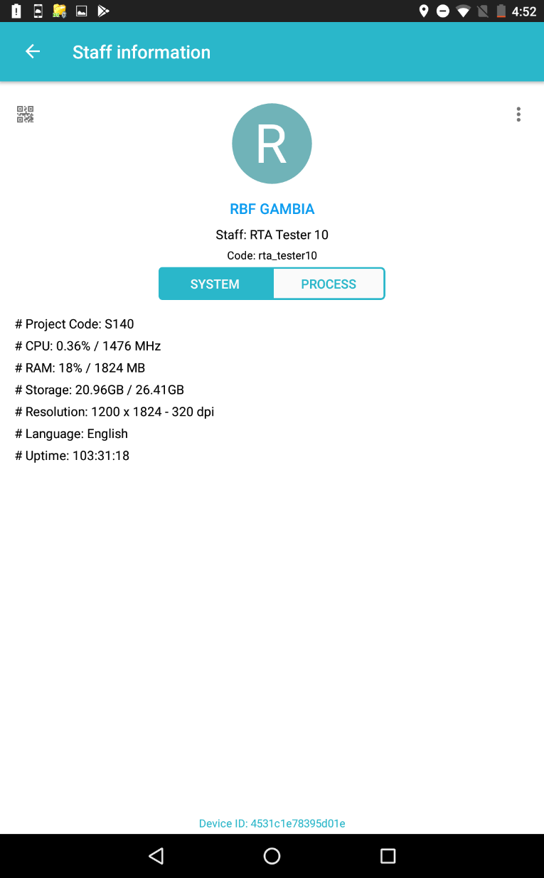
5.4. User Profile

Slide 33
THANK YOU!
Contact RTA:
Real-Time Analytics Company
Address: Unit 1101, 11th floor, 45 Vo Thi Sau Street, Da Kao Ward, District 1, Hochiminh City, Vietnam
Website: www.rta.vn
Email: info@rta.vn

